Slide 1
part 1/4 Fundamental concepts of frequentist statistics
Oussama Abdoun (MEng, PhD) – oussama.abdoun@pm.me
Bayesian Statistics – CRNL – dec 2024

Slide 2
On the menu
Objectives of session 1
develop a fine understanding of frequentist statistical inference, its interpretations & limitations
understand the fundamental divergence between frequentist and bayesian statistics
Concepts
Statistical inference
Statistical model
Parameter estimation
Uncertainty
Definitions of probability
Confidence interval
Null hypothesis testing & p-values
History of frequentist statistics
Associated code at: link

Slide 3
1.
Inference

Slide 4
A model of the scientific method
experiment
(in)validation of hypothesis
theory
hypothesis
prediction
Induction
uncertain and particular premisses
⇓
uncertain and general conclusions
deduction
inductive inference
Deduction
(True) statements
⇓
necessary conclusions
deduction
Notes:
In deduction, the conclusions are in a sense « contained » (although implicitly) in the premisses. In induction, the conclusions « go beyond » the premisses.

Slide 5
The chief guiding principle of both scientific and everyday knowledge [is] that it is possible to learn from experience and to make inferences from it beyond the data directly known by sensation. (…)
→

Slide 6
Inference is the use of sensations already experienced to derive information about sensations not yet experienced, to construct physical objects, and to describe the past and future of these physical objects.
Harold Jeffreys Scientific Inference (1931)
Notes:
https://www.scribd.com/book/262691032/Scientific-Inference

Slide 7

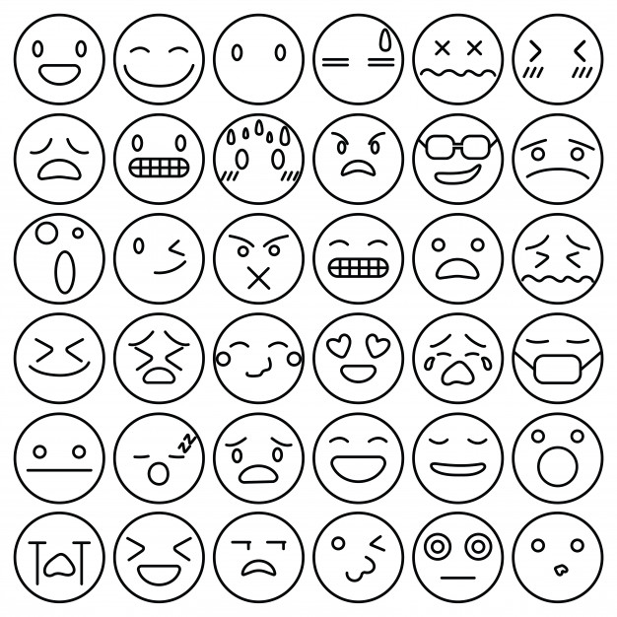

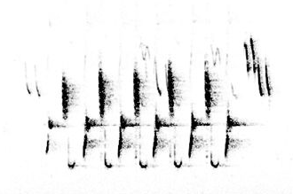
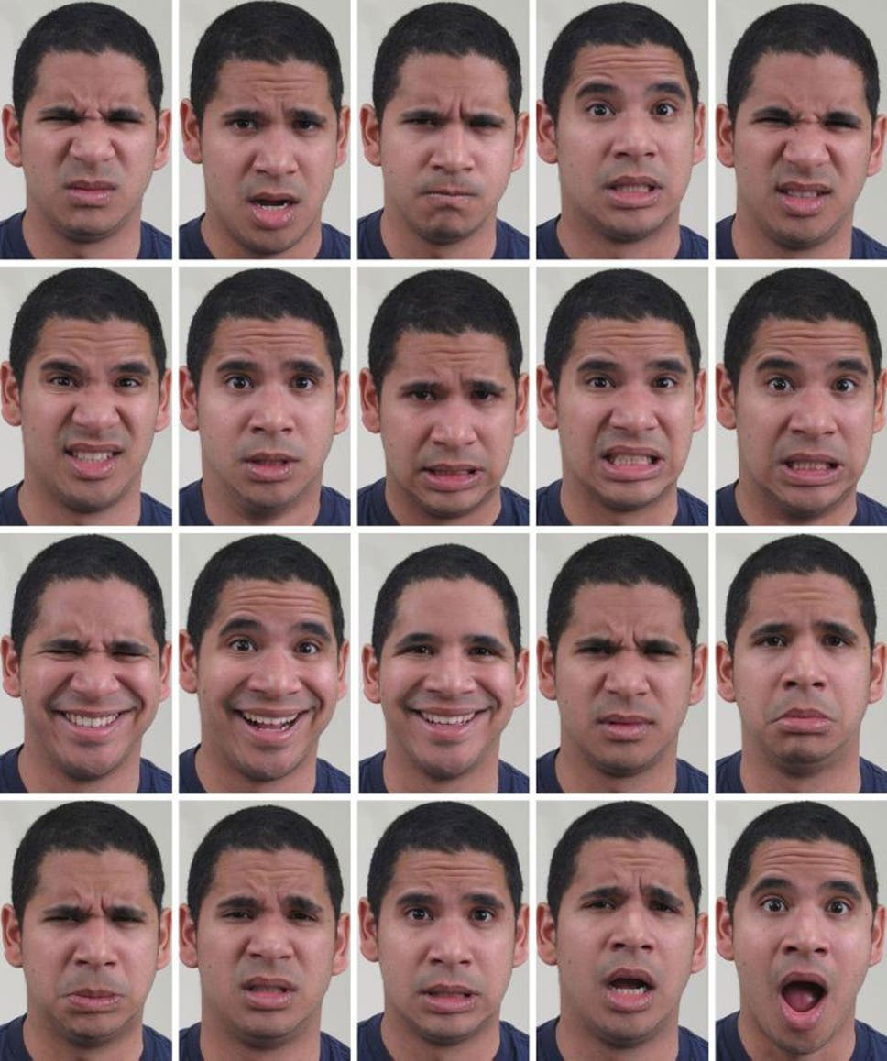

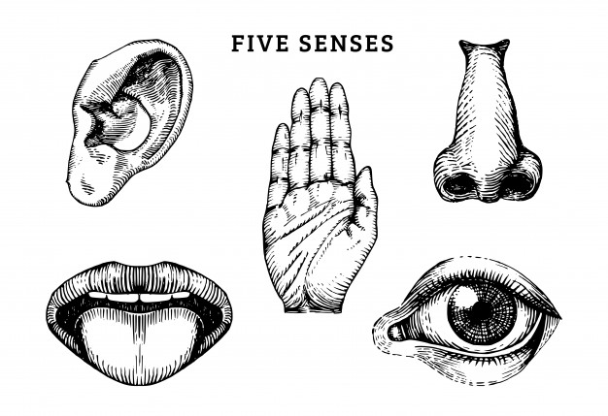
Everyday (perceptual) inference
inference
internal model
inference
internal model
inference
internal model
sensory input
sensory input
sensory input
Notes:
Our internal models of objects in the world and the kind of sensory inputs they generate, are constantly evolving and updated thanks to our experiences and learning.

Slide 8
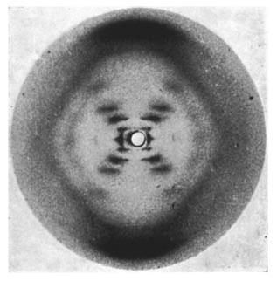
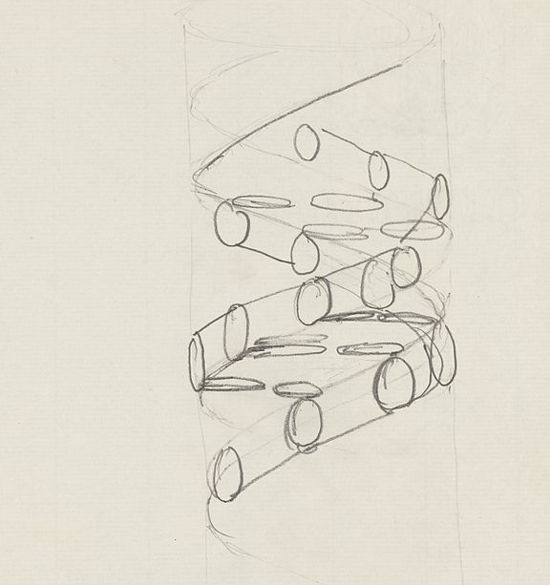
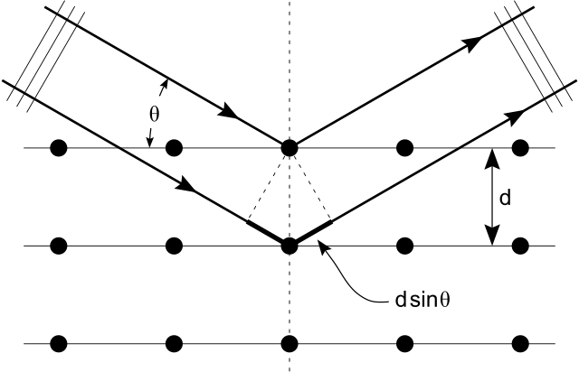
Inference in science
?
Atomistic model of matter
Wave model of light
Diffraction laws
Photo 51, X-ray diffraction, May 1952
Rosalind Franklin & Raymond Gosling
DNA structure, pencil sketch, 1953
Francis Crick

Slide 9
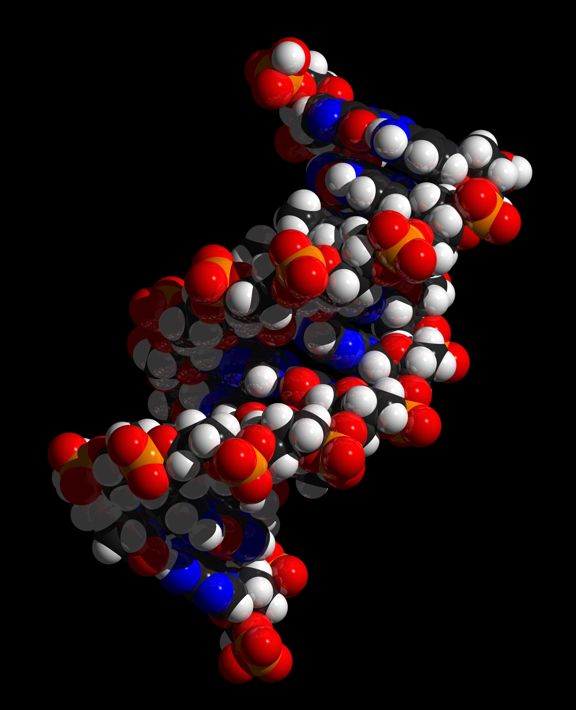
Inference in science
Inference
(“inversion” of the model)
prediction
(“forward” application of the model)
Photo 51, X-ray diffraction, May 1952
Rosalind Franklin & Raymond Gosling
Notes:
To produce the first sketch of the DNA structure, Francis Crick had to ask: “What is the most likely molecular structure capable of producing Photo 51, given what I know of how X-ray diffraction works?”

Slide 10
The place of statistical inference in science
TYPES OF REASONING
DEDUCTION
INDUCTION
ABDUCTION
statistical inference
Notes:
Within the domain of statistical inference, significance testing as we know it (p values) is on tool among many others.

Slide 11
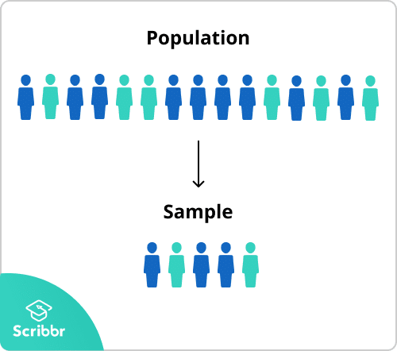
Statistical inference
The process of estimating the properties of an underlying population from a sample of data.
?
?
?
?
?
?
?
?
?
?
?
?
?
?
?
Sampling
(picking up random members of the population)
Inference
(“guessing” properties of the whole population)
Statistical inference = type of induction where uncertainty arises from having only partial data

Slide 12

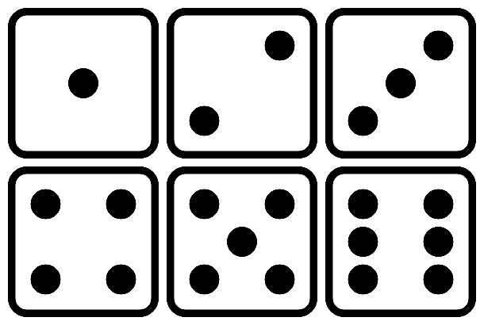
Statistical inference
Sampling and inference are required whenever observing the entire population of interest is impractical, either because:
the population is too large
the population is virtual (events)
sampling
inference

Slide 13
Statistical model
The model that allows statistical inference is called the statistical model. It is a generative model and makes use ofprobability distributions.
assumption on the population distribution
+
assumption on the sampling process*
statistical model
“inversion” of the statistical model
*usually considered as random, but see Tobit models for truncated samples
Notes:
The statistical model describes (in an idealized form) how the sample data has been generated. It describes the data as being realizations of a random variable following a parametrized distribution.

Slide 14
2.
Parameter estimation

Slide 15
Notations
True population distribution parameters: $$θ$$ For the normal distribution: $$θ=\left(μ, σ\right)$$
(unknown FOREVER)
Estimated population distribution parameters: $$\hat{θ}$$ $$\text{For} \text{the} \text{normal} \text{distribution}\text{:}$$ $$\hat{θ}=\left(\hat{μ}, \hat{σ}\right)$$
(calculated from available data)
?
?
?
?
?
?
?
?
?
?
?
?
?
?
?
sampling
inference
Sample values: $$x_{i}$$ Sample statistics: $$\overline{X},s_{n}^{2}$$

Slide 16

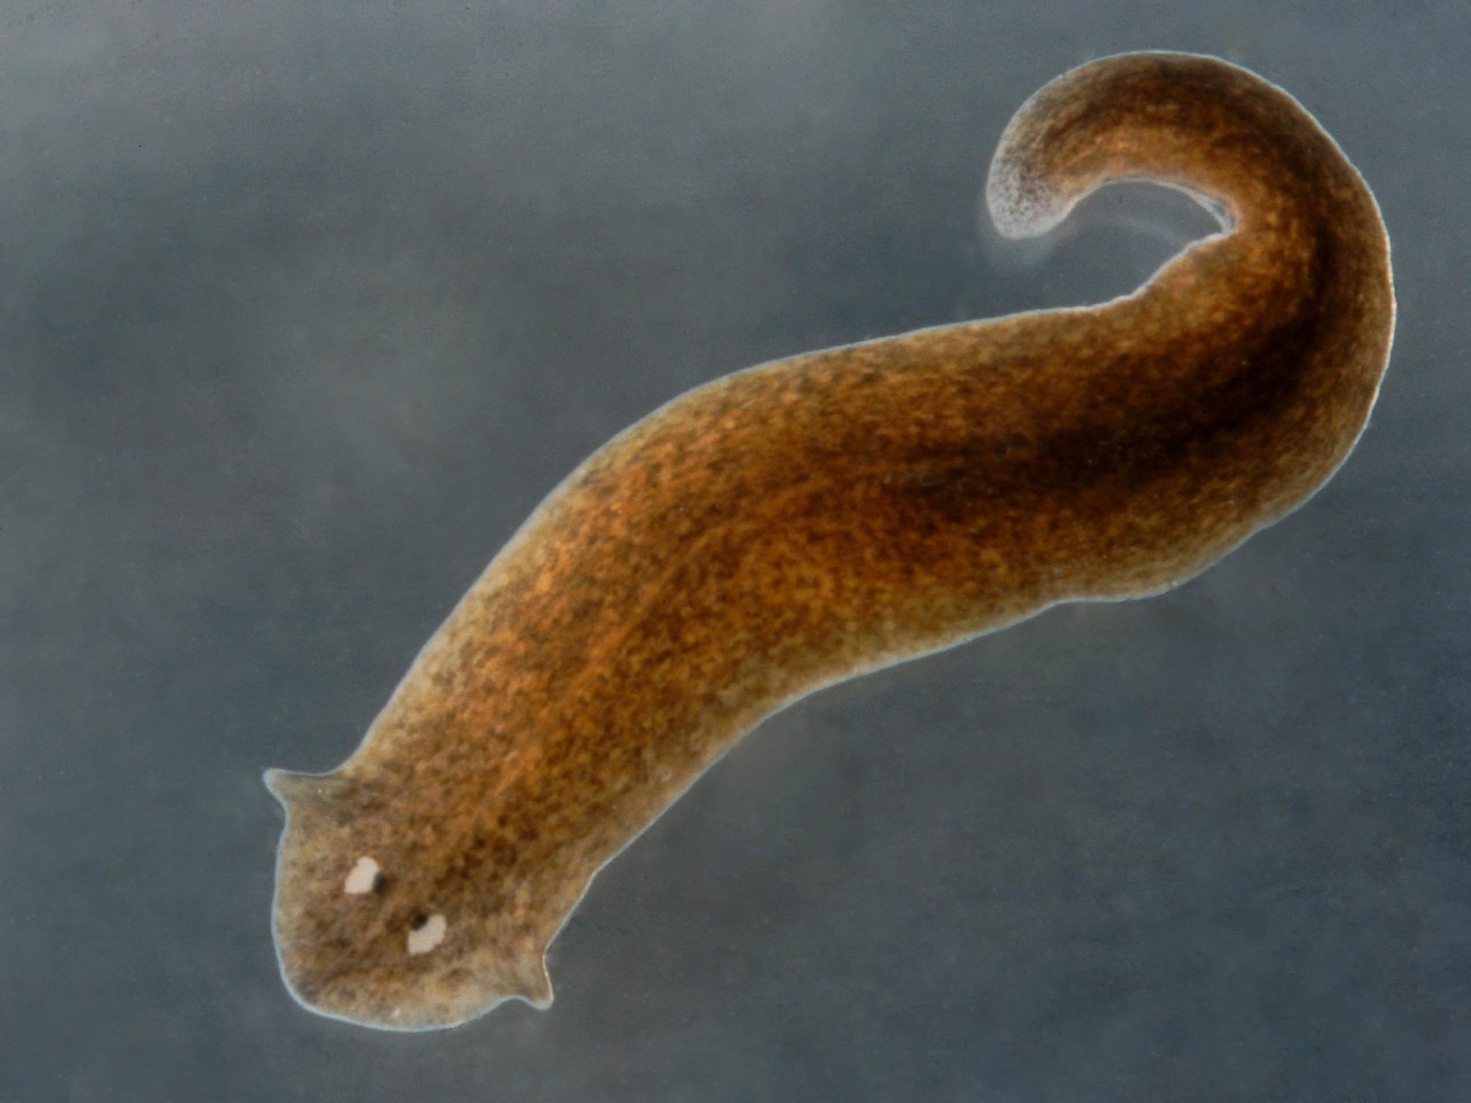
Point estimates: an example
You find 17 specimens of a curious species, the planarian worms. Laser measurements yielded the following data for the length of the planarians (in mm):
14.976, 7.04, 11.588, 14.46, 6.876, 9.258, 10.444, 5.425, 12.508, 11.844, 7.695, 4.642, 6.916, 2.947, 10.423, 9.558, 10.783
What should we do now?
Visualize the data
Describe the statistical properties of the sample
Specify the statistical model: $$X\sim N(μ,σ^{2})$$
Estimate the parameters of the model (i.e. the properties of the underlying population)
Notes:
X Back on earth, everbody is excited except biologists who want to know the size and weight of the first discovered exospecies.

Slide 17
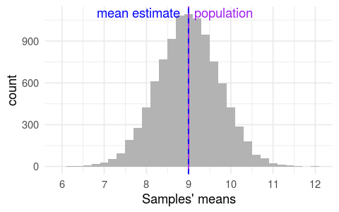
Estimating the population mean
Intuitively, what is the best estimate of $$μ$$ ?
The sample mean: $$\hat{μ}=\overline{X}$$
A good estimator should converge towards the true population.
We can evaluate how good our estimator is using simulations (“God’s view”).
On the left, we have generated 10,000 random samples of 17 planarians each. We have fixed the true parameters: $$μ=9$$ and $$σ=3$$. This is equivalent to 10,000 replications of the same study with the same sample size, on the exact same population.
Even though some samples’ means are really far from the population mean, as a whole samples converge toward the true value, indicating that this is a good estimator.
(sampling distribution)
Notes:
We also need to estimate the population variance to get a good idea of what the population loos like, and make predictions about future observations, including being able to say whether a given sample can plausibly come from that population or not.

Slide 18
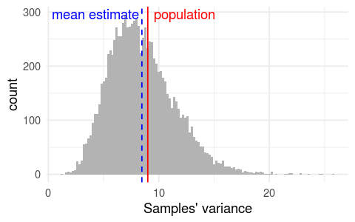
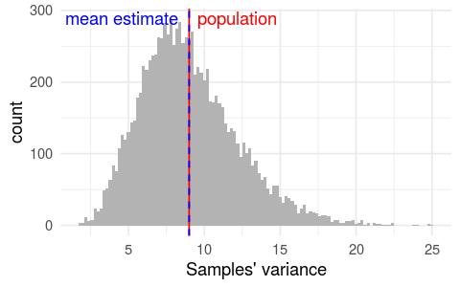
Estimating the population variance
What about the population variance $$σ^{2}$$
“Intuitive” estimator: the sample variance $$s_{n}^{2}$$
=> not too bad but systematically underestimates the true value!
Unbiased estimator (Bessel correction): $$\frac{n}{n−1}s_{n}^{2}$$
“Intuitive” estimator of variance
Unbiased estimator of variance
Notes:
We also need to estimate the population variance to get a good idea of what the population loos like, and make predictions about future observations, including being able to say whether a given sample can plausibly come from that population or not.

Slide 19
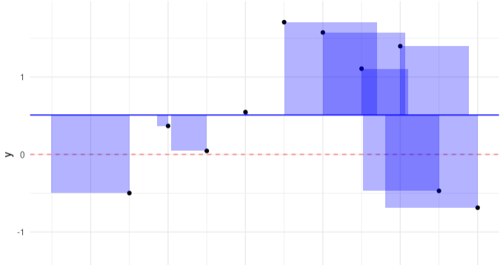
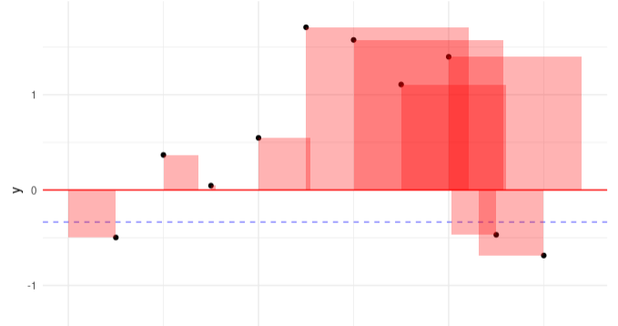
Estimating the population variance
Why is the sample variance a biased (under)estimate of the true population variance?
Sample variance, based on the sample mean
Sample variance, based on the true mean
sum of squares = 7.35
sum of squares = 9.94
Using the sample mean to estimate variance tends to "pull" the calculated deviations closer to zero than they would be if we were able to use the true population mean. That’s because the sample mean, being calculated from the sample points, is always closer to them than the population mean..
Notes:
We also need to estimate the population variance to get a good idea of what the population loos like, and make predictions about future observations, including being able to say whether a given sample can plausibly come from that population or not.

Slide 20
Maximum likelihood estimation (MLE)
Mathematically, where do these estimators come from?
Conceptually, statistical inference consists in finding the most plausible/likely values for the population parameters, given the observed data. Mathematically, this means finding the population parameters values $$θ$$that maximize the following probability:
$$p({θ|x}_{1},x_{2},{…,x}_{n})$$
⇦ bayesian statistics
This is difficult. Instead, we can go for a simpler alternative: finding the values of population parameters for which the observed data are most likely, i.e. maximizing:
$$p(x_{1},x_{2},{…,x}_{n}|θ)$$
⇦ frequentist statistics
i.e., assuming that the $$n$$ observations are independent, to maximize the likelihood function:
$$ℒ\left(θ;x\right)=\prod_{i=1}^{n}{p(x_{i}|θ)}=\prod_{i=1}^{n}{f(x_{i}|θ)}$$
where $$f$$ is the (hypothesized) probability density function of the population.
For an application on parameter estimation of normal distributions, see on Wikipedia: tinyurl.com/y2jwpxx2
Notes:
The joint probability of independent events is equal to the product of univariate probabilities.

Slide 21
Maximum likelihood estimation (MLE)
MLE is the dominant estimation method in frequentist statistics. Why?
flexibility: can be applied to a wide range of statistical models and distributions
computational tractability: relatively easy/fast to calculate (using numerical optimization algorithms)
Limiting properties:
consistency: it converges to the true population value
efficiency: it produces estimates with the lowest possible variance
Bayesian statistics use entirely different estimation methods. But there are mathematical equivalences:
MLE ⇔ maximum a posteriori (MAP) with a uniform prior
Notes:
The joint probability of independent events is equal to the product of univariate probabilities.

Slide 22
3.
Confidence intervals

Slide 23
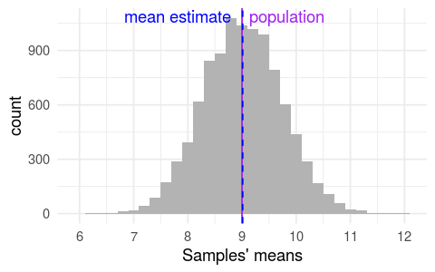
Precision of population mean estimates
Our planarian sample is small (17 specimens only).
How much can we trust its population estimates?
Many samples are way off! (~13%)
And your specific sample could be one of them... You can’t know!
(sampling distribution)

Slide 24
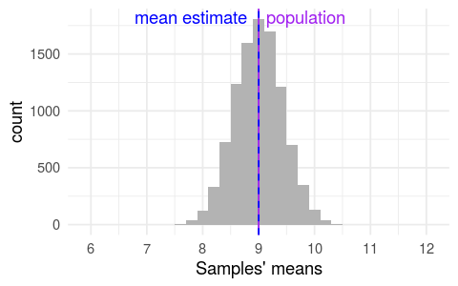
Precision of population mean estimates
A larger sample would be more precise!
For example, with n = 50:
Fewer extreme samples (~0.5%)

Slide 25
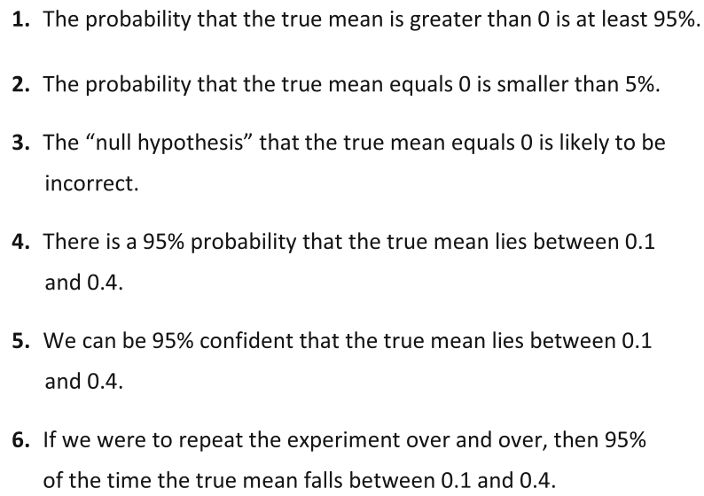
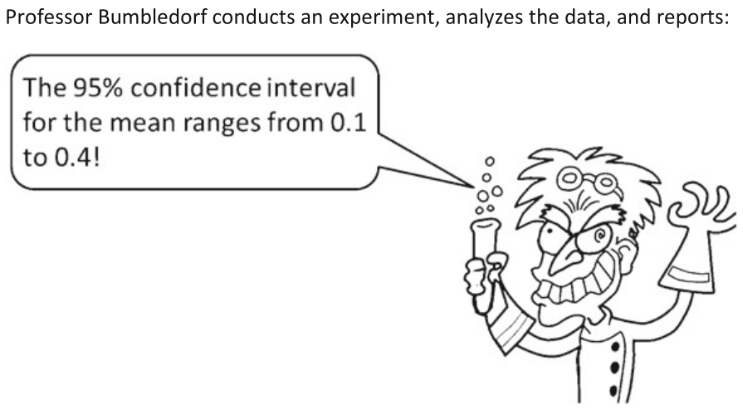
Test
[ ANSWERS IN THE NEXT SLIDE ]
Notes:
The joint probability of independent events is equal to the product of univariate probabilities.

Slide 26
Test
A CI does not make a probability statement about population parameters. The confidence level (e.g., 95%) refers to the long-term success rate of the method, that is, how often this type of interval will capture the parameter of interest.
If we were to repeat the experiment over and over, then, in the long run, 95% of the CIs we would obtain would contain the true mean.
Notes:
The joint probability of independent events is equal to the product of univariate probabilities.

Slide 27
Everybody get confidence intervals wrong Hoekstra, Morey, Rouder & Wagenmakers (2014). Robust misinterpretation of confidence intervals. Psychonomic Bulletin & Review (doi:10.3758/s13423-013-0572-3)
Study. 476 students and 120 researchers (including PhD students) were surveyed about their knowledge of confidence intervals using the test in the previous slide.
Conclusion from the authors. “The APA Manual strongly encourages the use of CIs. Consequently, one might expect that most researchers in psychology would be well-informed about the interpretation of this rather basic inferential outcome. Our data, however, suggest that the opposite is true: Both researchers and students in psychology have no reliable knowledge about the correct interpretation of CIs. Surprisingly, researchers’ self-reported experience in statistics did not predict the[ir accuracy]. Even worse, researchers scored about as well as first-year students without any training in statistics.”

Slide 28
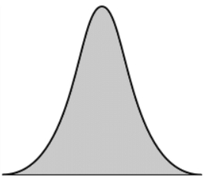
Two views of probability
Definition of probability
View on model parameters
Probability apply to
Frequentist
long-run frequency of events
fixed (but unknown) constants
data only
Bayesian
degree of belief / certainty
random variables
data & parameters

Slide 29
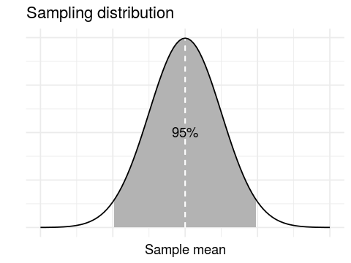
CIs & sampling distribution
Let’s calculate the parameters of the sampling distribution.
$$\overline{X} \sim N(μ_{\overline{X}}\text{,}{{ σ}_{\overline{X}}}^{2})$$
Mean $$μ_{\overline{X}}$$
We know that $$\overline{X}$$ is a good estimator of $$μ$$, so: $$μ_{\overline{X}}=μ$$
Mathematical derivation: $$μ_{\overline{X}}=E\left[\overline{X}\right]=E\left[\frac{\sum{X_{i}}}{n}\right]=\frac{1}{n}\sum{E[X]}=\frac{1}{n}nμ=μ$$
Variance $${{ σ}_{\overline{X}}}^{2}$$
Mathematical derivation: $${{ σ}_{\overline{X}}}^{2}=Var\left(\overline{X}\right)=Var\left(\frac{\sum{X_{i}}}{n}\right)=…=\frac{σ^{2}}{n}$$
Therefore: $$\overline{X} \sim N(μ\text{,}\frac{σ^{2}}{n})$$. This is consistent with our previous simulations showing that the distribution of sample means narrows down when we increase the sample size $$n$$.

Slide 30
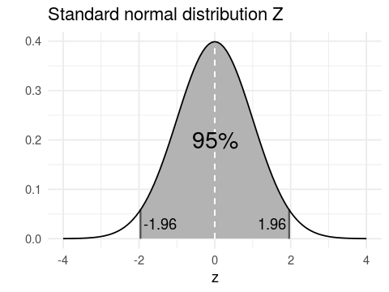
CIs & sampling distribution
If $$σ$$ is known, we can standardize* $$\overline{X}$$:
𝑋−𝜇𝜎/𝑛~ N0,1=𝑍
The middle 95% of the $$Z$$ distribution lies between -1.96 and 1.96. Therefore, this will be true for the samples that fall in the middle 95% of the sampling distribution:
𝑋−1.96𝜎𝑛≤𝜇≤𝑋+1.96𝜎𝑛
* i.e. subtract the mean and divide by the standard deviation
formula of the confidence interval!
⇒ confidence intervals are constructed using properties of the sampling distribution
⇒ confidence intervals should be interpreted in the context of repeated sampling, not in terms of the single sample at hand

Slide 31
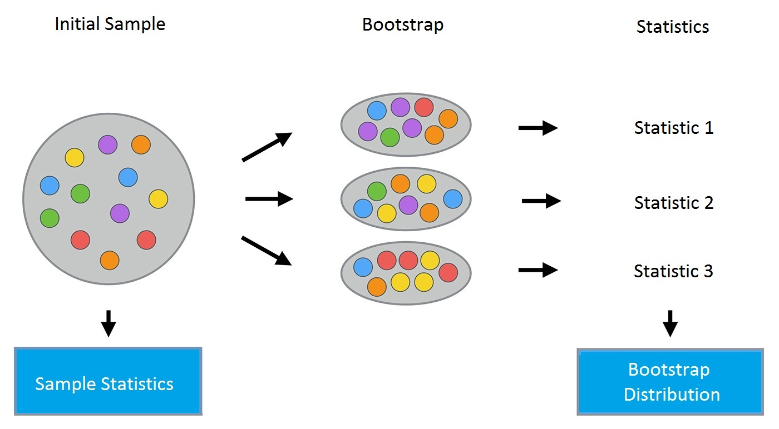
CIs & sampling distribution
Bootstrapping estimation
Population
Initial sample
Bootstrap samples
Summary statistics
Bootstrap distribution
~ simulated sampling distribution
?
sampling with replacement
The middle interval that contains X% of the bootstrap distribution is a valid X% CI.

Slide 32
Confidence intervals Interpretation
Remember how we constructed the confidence interval: for samples that are in the middle 95% of the sampling distribution, we have:
𝑋−1.96𝜎𝑛≤𝜇≤𝑋+1.96𝜎𝑛
So the correct interpretation is: 95% of 95% confidence intervals of all possible samples (that have been or will be or could be collected), contain the true population mean.
You can’t know whether your particular sample belongs to this middle 95%. And once the data is collected, the confidence interval of a sample either does or does not contain the true population mean. It is meaningless to say it has 95% probability of containing the true population mean! see visualization at rpsychologist.com/d3/ci/

Slide 33
A quick test Right or wrong?
Context. The planarians have been cut, and fully regenerated. The new lengths have been measured, and the 95% CI is [7.2, 11.4] mm.
1.
If we cut them again and let them regenerate, the average new final length has a 95% probability to fall between 7.2 and 11.4
2.
Planarians have been bred, and samples of 17 specimens have been sent to many labs across the world for regeneration experiments. All scientific collaborators have agreed to publish results in the form of 95% CIs. Therefore, we can expect 95% of the future reported CIs to:
(a) overlap with the original [7.2, 11.4] CI
(b) contain the true population value

Slide 34
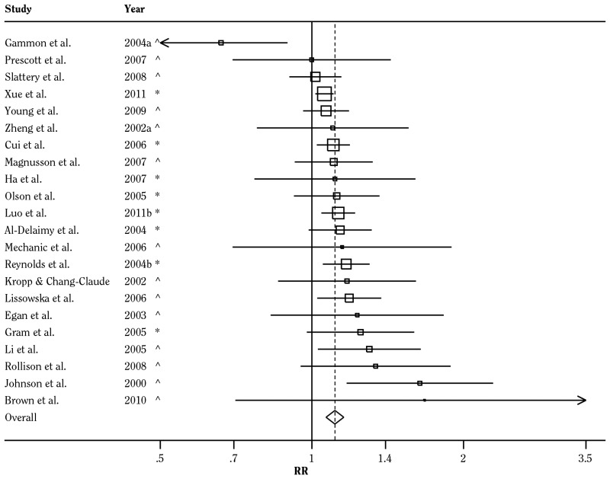
Why CIs are useful nonetheless
If all intuitive interpretations of CIs are wrong, what’s the point of CIs?
Relative risk of breast cancer in people who started smoking before the age of 20
1) Multiple CIs can be combined to produce a more precise estimate
The Health Consequences of Smoking—50 Years of Progress (2014)

Slide 35
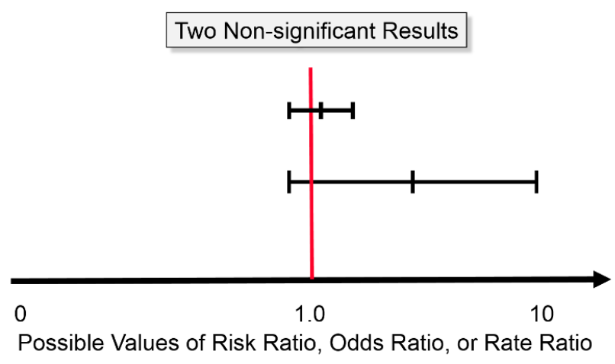
Why CIs are useful nonetheless
If all intuitive interpretations of CIs are wrong, what’s the point of CIs?
1) Multiple CIs can be combined to produce a more precise estimate
Very informative: suggests only small effect sizes at best
Poorly informative: compatible with both no and high effect sizes
2) The width of the CI tells us how informative is the data

Slide 36
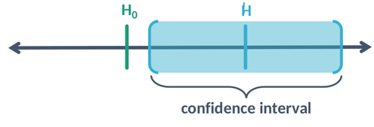
Why CIs are useful nonetheless
If all intuitive interpretations of CIs are wrong, what’s the point of CIs?
p < .05 for any
$$H$$ out of the CI_{95%}
p > .05 for any
$$H$$ in the CI_{95%}
1) Multiple CIs can be combined to produce a more precise estimate
2) The width of the CI tells us how informative is the data
3) CIs and p values are related, such that the CI gives a range of values compatible with the data (in the sense of significant testing)

Slide 37
Frequentist vs. Bayesian CIs
The correct interpretation of confidence intervals is highly un-intuitive.
It requires us to conceive of our sample as only one realization of an experiment that could be repeated a large number of times. The interpretation of confidence intervals is based on the frequentist view of probability as the long-run expected frequency of occurrence.
Typically, we misinterpret the confidence interval in a way that matches what we would like to get: an interval for which we are 95% confident (or there is 95% chance) that it contains the true population parameter.
Such intervals exist, they are called credible intervals. They rest on the Bayesian view of probability as level of certainty, or degree of plausibility or belief. However, credible intervals are dependent on prior information to be specified by the human analyst.
The word confidence is a terrible choice for confidence intervals. Some authors have proposed to replace it by uncertainty intervals or compatibility intervals (Gelman & Greenland 2019)

Slide 38
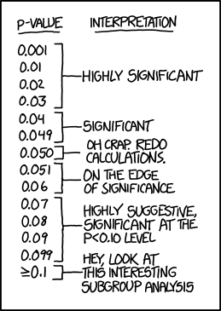
4.
Null hypothesis significance testing (NHST)
“If all else fails, use "significant at a p>0.05 level" and hope no one notices."
xkcd #1478

Slide 39
The modern NHST procedure
1
Collect data.
2
Specify a statistical model (i.e. a distribution for the population) with parameters $$θ.$$
3
Specify the null hypothesis $$H_{0}$$ over one of the parameters.
4
Find a way to summarize the data in one value, the test statistic, such that its sampling distribution is defined and calculable under the null hypothesis. This is a job for statisticians (phew!)
5
Calculate $$p\left(sample statistic | H_{0}\right)$$, aka the p value: the probability of observing the data assuming the null hypothesis

Slide 40
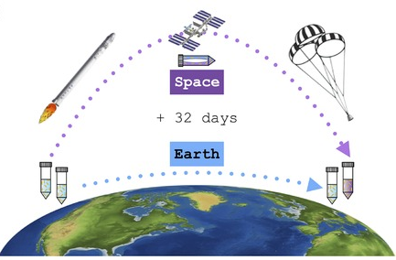
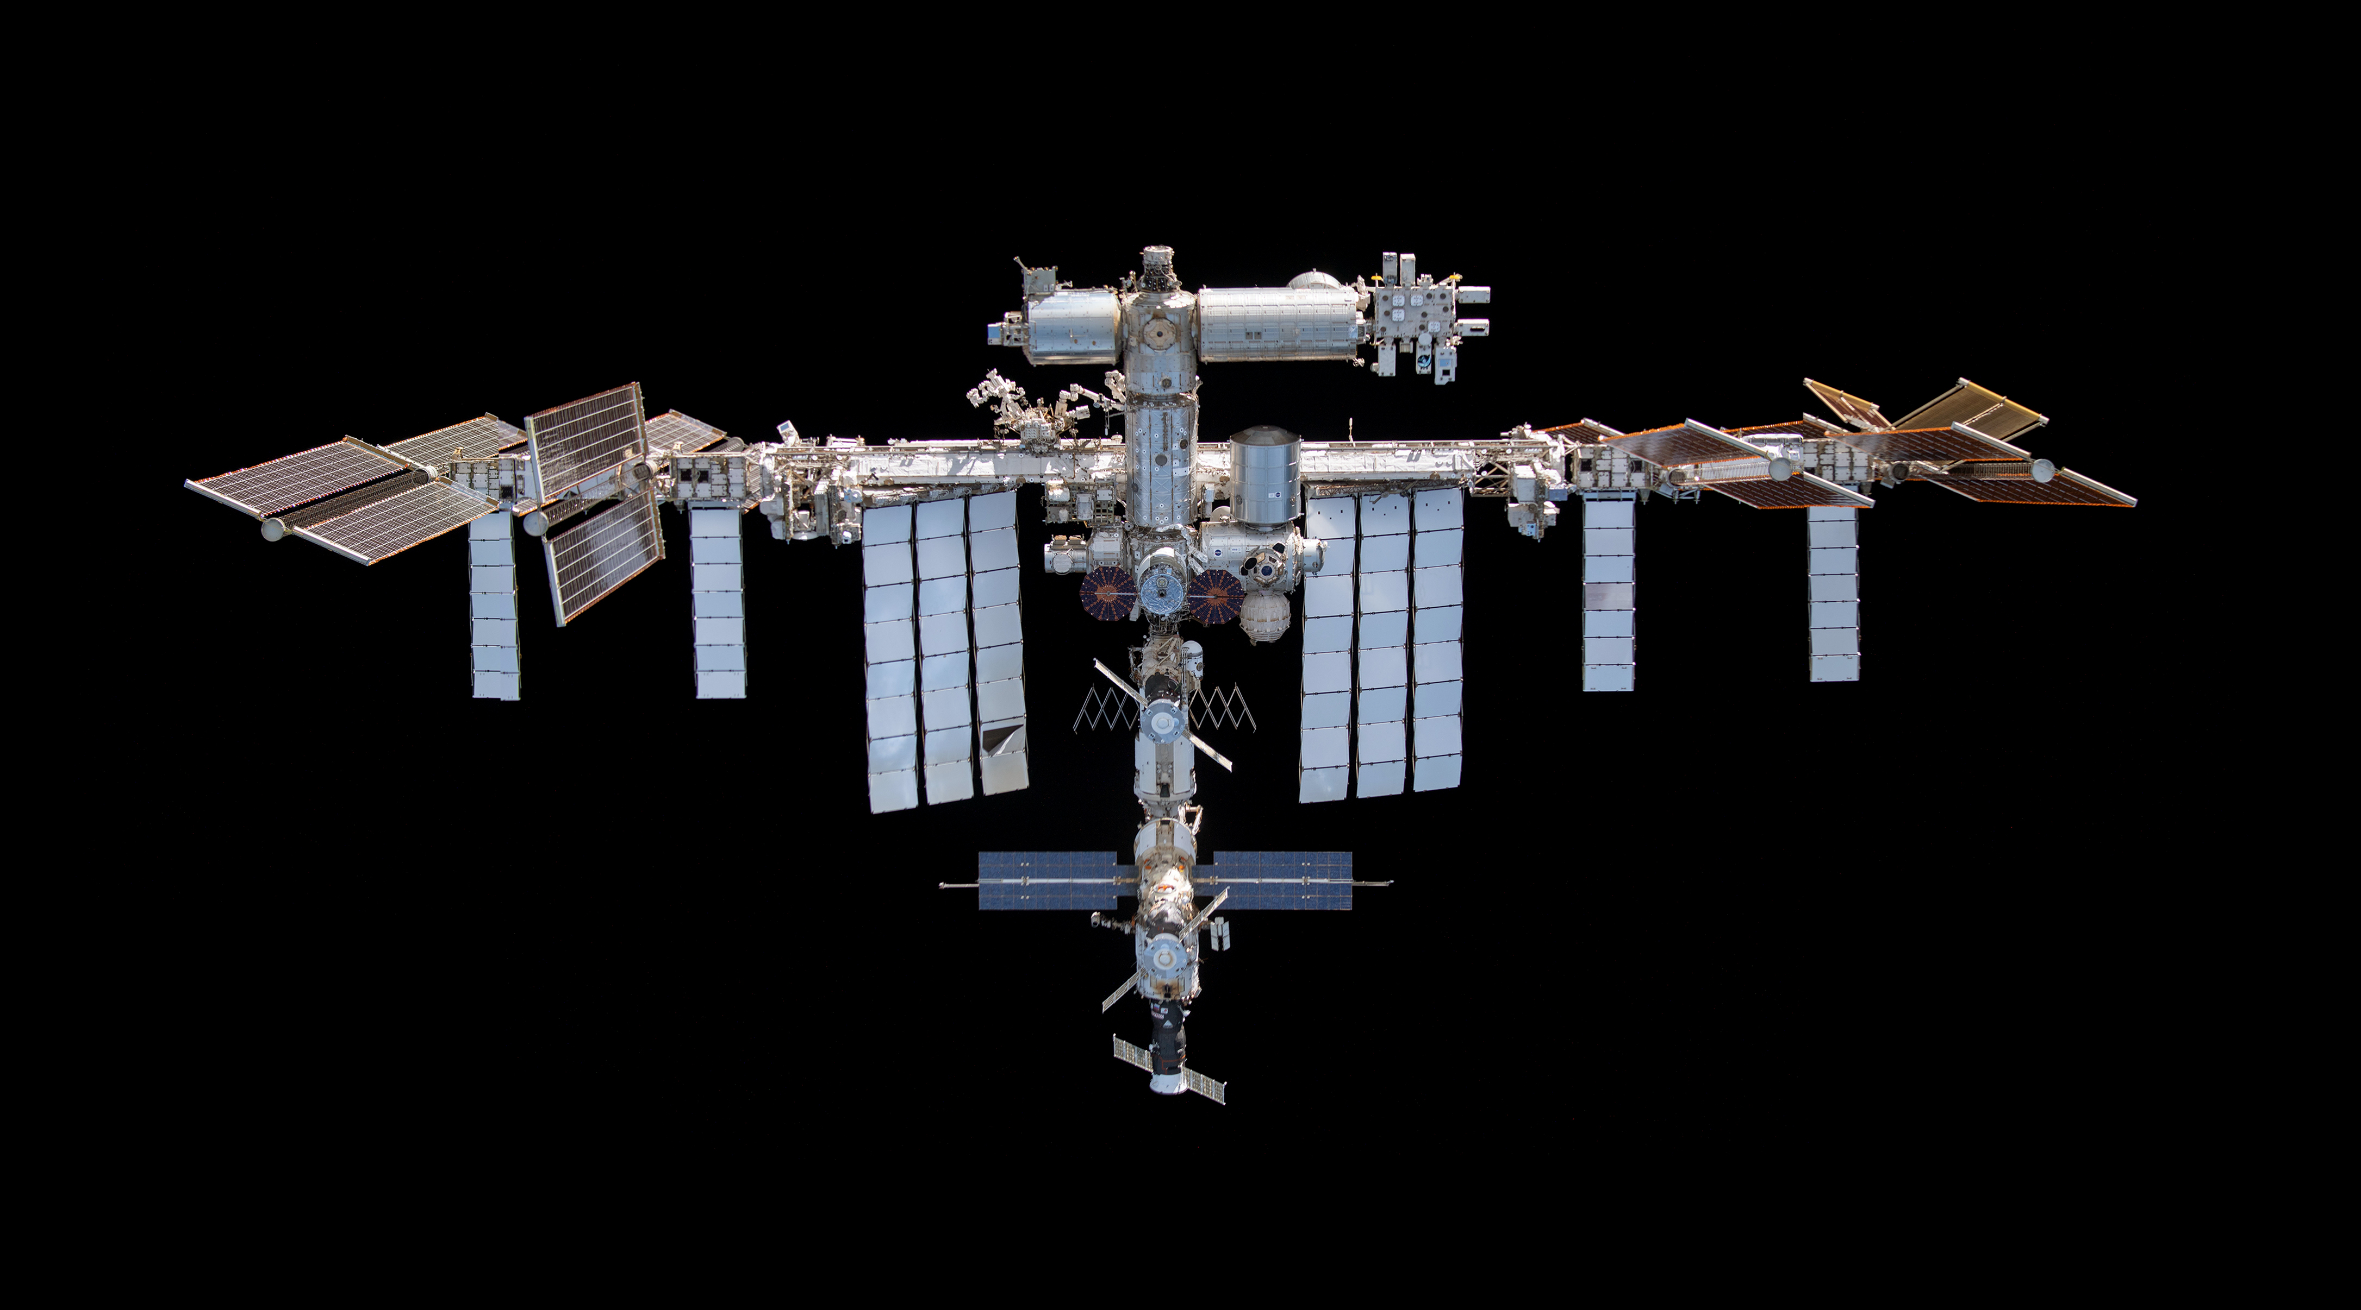
Example scenario
Morokuma et al. 2017. Planarian regeneration in space: Persistent anatomical, behavioral, and bacteriological changes induced by space travel. Regeneration (doi:10.1002/reg2.79)
Notes:
X Back on earth, everbody is excited except biologists who want to know the size and weight of the first discovered exospecies.

Slide 41
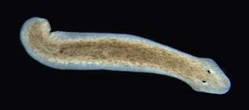
Example: mean of the normal distribution
Scenario A (the paired two-sample case)
Prior to being sent on the ISS, the 17 planarians have been measured. Biologists wonder whether they have grown or shrinked during their space journey.
Trick: we work with $$X_{D}=X_{2}−X_{1}$$, the paired difference between the two sets of data (the first and second length measurements), i.e. the amount of growth.
We assume $$X_{D} \sim 𝒩(μ_{D}\text{,}{{ σ}_{D}}^{2})$$
1
data collection
$$X_{1}$$
$$X_{D}$$
2
$$X_{2}$$
statistical model

Slide 42
Example: mean of the normal distribution
3
The null hypothesis is that the worms have neither grown nor shrank on average:
$$H_{0}:μ_{D}=0$$
null hypothesis
When we constructed confidence intervals, we have already shown that:
𝑋𝐷−𝜇𝐷𝑠/𝑛 ~ 𝑡𝑛−1
Therefore, under $$H_{0}$$, the quantity 𝑋𝐷𝑠/𝑛 is a test statistic whose sampling distribution is known: it is the t-distribution with $$n−1$$ degrees of freedom.
4
test statistic with calculable sampling distribution

Slide 43
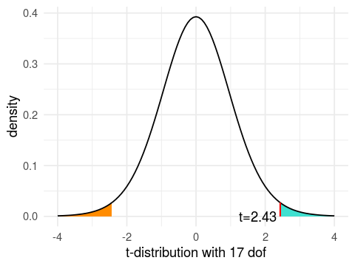
Example: mean of the normal distribution
5
$$p\left(abs\left(t\right)≥2.43 | μ_{D}=0\right)=0.027$$

Slide 44
Significance testing
It appears that the probability of observing data as extreme as ours under the null hypothesis is quite small (2.7%). So small that we might be tempted to rule out the null hypothesis as a plausible source of data.
One further (but optional) step is to use a significance level $$α$$ (chosen before data collection!) as a criteria to decide whether or not we have sufficient evidence against the null hypothesis:
$$p<α$$ : we reject $$H_{0}$$
$$p≥α$$ : we do not reject $$H_{0}$$
6
decision

Slide 45
A glaring gap
What we intuitively desire:
A frequentist alternative:
What frequentist NHST gives us:
most plausible values of $$θ$$ given the data $$y$$
$$a\left(θ | y\right)$$
$$p\left(Y≥y | H_{range}\right)$$
$$p\left(Y≥y | H_{0}:θ=θ_{0}\right)$$
Can test a hypothesis of practical significance
Based on data we have not actually observed
Tests a hypothesis that we are not interested in
Based on data we have not actually observed
⇒ offered by Bayesian statistics, using the Bayes law:
$$p\left(θ | y\right)= \frac{p\left(y | θ\right).p(θ)}{p(y)}$$

Slide 46
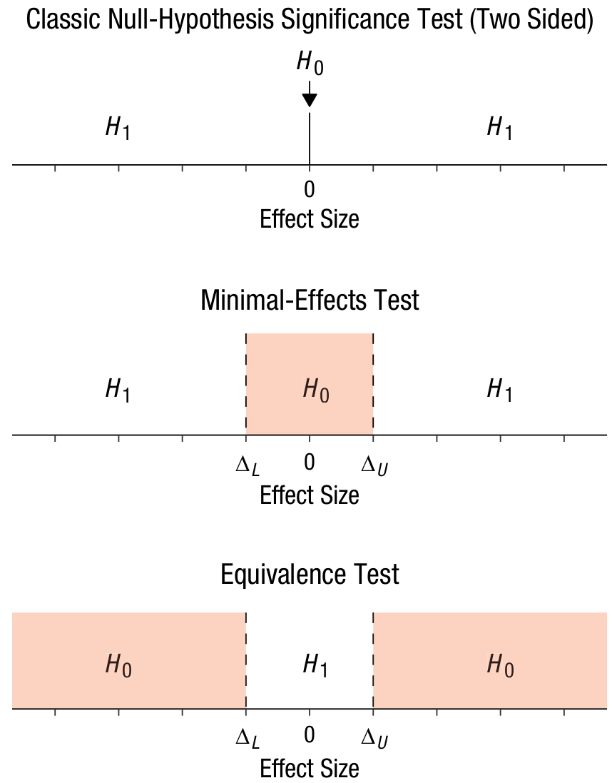
Equivalence tests aka TOST
see Lakens, Scheel & Isager 2018 (doi.org/10.1177/2515245918770963)

Slide 47

Misinterpretations of p-values
Cite 6 common misinterpretations of p-values

Slide 48
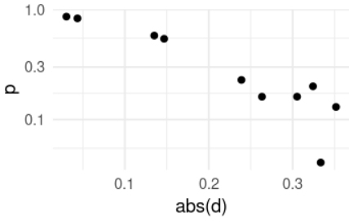
Misinterpretations of p-values
1. The p-value is the probability of the null hypothesis.
2. A p-value below the significance level $$α$$ is evidence for the experimental hypothesis (e.g., that there is a difference between two populations’ means).
3. A very high p-value is a strong evidence that there is no reliable effect.
4. The probability of the experimental hypothesis can be deduced from the p-value.
5. Smaller p-values indicate larger effect sizes
6. If the p-value is very small, most replications will be statistically significant too.
See also this excellent post from Daniel Lakens, discussing several misinterpretations and debunking them with simulations and graphs: daniellakens.blogspot.com/2017/12/understanding-common-misconceptions.html
The p-value is not a perfect predictor of effect size

Slide 49
Let’s play !
Supposons que l’on réalise un test sur un jeu de données, pour lequel on sait que l’hypothèse nulle est vraie. Selon vous, quelles sont les probabilités relatives d’obtenir une p-value de 0.01 ? 0.10 ? 0.90 ? Comment ces probabilités relatives changeraient-elles en augmentant la taille d’échantillon, par exemple de 15 à 120 ?
N = 15
N = 120
probabilité
probabilité
p = 0.01
p = 0.10
p = 0.90
p = 0.01
p = 0.10
p = 0.90

Slide 50
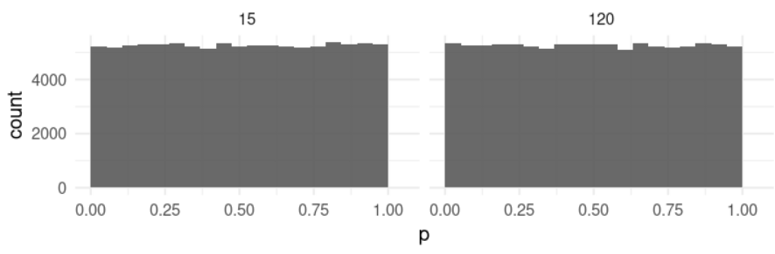
Let’s play !
N = 15
N = 120
The intuitive expectation:
— Large p-values are more likely than small ones under H0
— This pattern is exacerbated with increasing sample size
probabilité
probabilité
p = 0.01
p = 0.10
p = 0.90
p = 0.01
p = 0.10
p = 0.90
Actual results from simulations:
⇒ the distribution of p-values is always uniform when the null is true.

Slide 51
Let’s play !

Slide 52
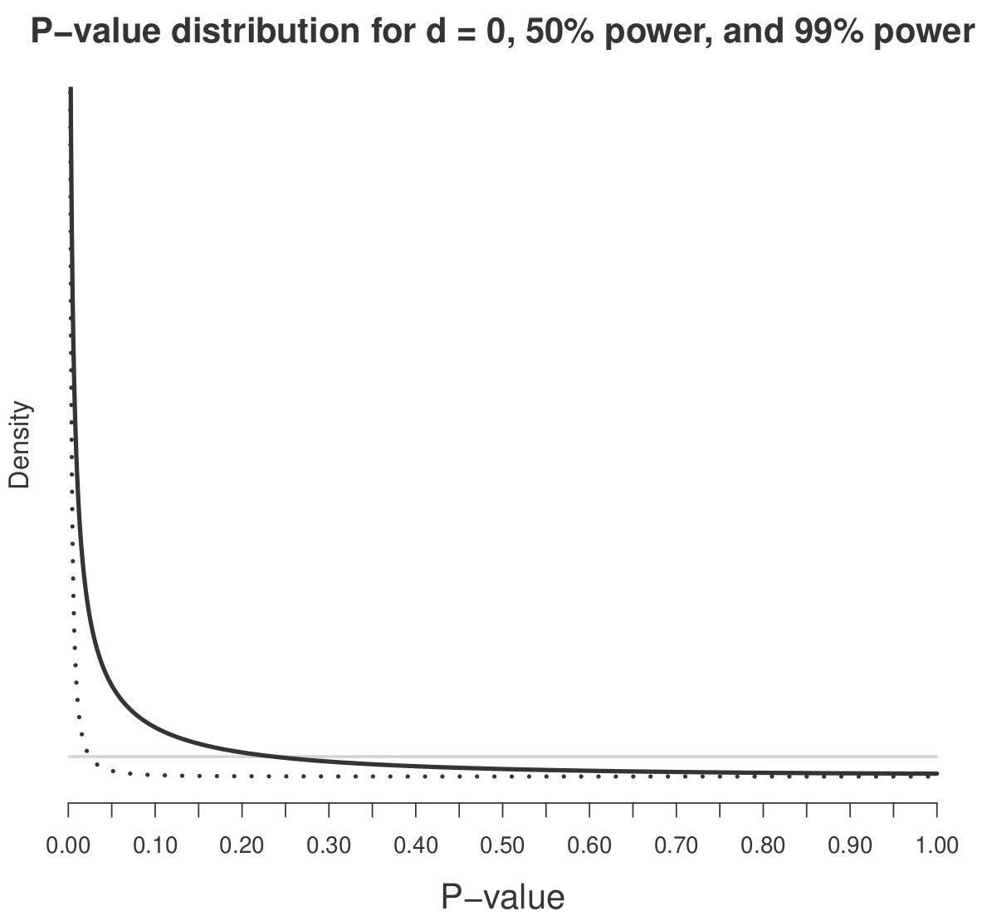
Let’s play !
The distribution of p-values gets sharper when statistical power increases.

Slide 53
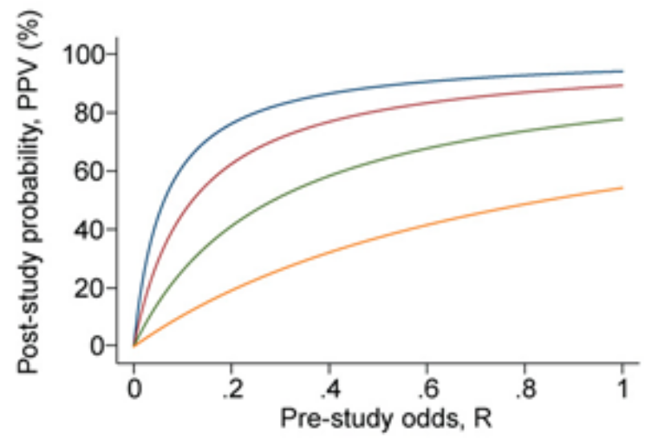
Let’s play !
Une étude teste un effet en lequel vous avez de bonnes raison théoriques (pensez-vous) de ne pas croire. La méthodologie de l’étude est irréprochable.
L’étude a utilisé un échantillon de 21 participants, une taille un peu plus faible que la moyenne du domaine.
L’étude a utilisé un échantillon de 210 participants, une taille beaucoup plus importante que la moyenne du domaine.
Pour le test statistique central de l’étude, les auteurs rapportent p = 0.005.
Comment réagissez-vous à ce résultat ?
increasing power
A: je n’y crois toujours pas, ils ont simplement eu de la chance !
B: Ok, je dois admettre que j’ai peut-être tort.
C: Je ne sais plus quoi penser...

Slide 54
Limited interpretation of the p-value
Sensitivity to sample size: even trivial effects can produce significant p-values, given sufficiently large sample sizes
Sensitivity to statistical power: the evidential value of a single p-value depends on the statistical power of the test (Lakens 2022)
Sensitivity to base rate: the evidential value of a single p-value depends on the frequency of true hypotheses among all hypotheses tested in the scientific field (compare confirmatory RCTs with exploratory high-throughput genomics) [Ioannidis 2005]
Arbitrary cutoff: The difference between p = .049 and p = .051 is not significant! (Gelman & Stern 2006, doi:10.1198/000313006X152649) ⇒ risk of dichotomous thinking and overlooking meaningful results just above the threshold.

Slide 55
A cascade of consequences
publication bias ⇒ when compounded with low statistical power, leads to overestimation of effect sizes
p-hacking: deliberate or involuntary ⇒ increases false positives, i.e. decreases replicability
obsessive overreliance on p-values ⇒ occludes other sources of scientific evidence (prior information, plausible mechanism, consistency, etc.) ⇒ detrimental to theorization efforts (Meehl 1978, doi:10.1016/j.appsy.2004.02.001) ⇒ hinders the improvement of statistical literacy

Slide 56

The pyramid of importance in statistics
How we have learned...
...How we should do it
confidence intervals
the icing on the cake
p-values
estimate/ effect size
estimate/ effect size
p < .05
the cake
confidence intervals

Slide 57
How did we get there?
1925+ : Ronald Fischer develops “significance testing” to provide a mathematically rigorous treatment of randomness in data, so as to extract useful information from small samples. He restricted his procedure to exploratory research (when we have no theory and no hypothesis), insisted that the results made sense only for well controlled designs, and viewed individual p values as mere data for meta-analysis.
1928+ : Neyman and Pearson set up to improve on Fisher’s approach and ended up inventing an entirely new procedure to be able to decide between two competing hypotheses, based on effect size and type I and II error rates. It was developed for quality control of standardized manufactured objects.
1940 – 1942 : Statistical textbooks for psychologists blend Fisher and Neyman-Pearson procedures, creating inconsistent chimeras that have been passed from generation to generation, until us.
Gigerenzer (2004). Mindless statistics. The Journal of Socio-Economics (doi:10.1016/j.socec.2004.09.033)
Nuzzo (2014). Scientific method: Statistical errors. Nature (doi:10.1038/506150a)
Perezgonzalez (2015). Fisher, Neyman-Pearson or NHST? A tutorial for teaching data testing (doi.org/10.3389/fpsyg.2015.00223)

